Slide 1
DESIGN (ANTI-)PATTERNS
Object pool

Slide 2
WHAT ARE DESIGN PATTERNS
A software design pattern is a general, reusable solution to a commonly occurring problem. It is not a finished design that can be transformed directly into source or machine code. It is a description or template for how to solve a problem that can be used in many different situations. Design patterns are formalized best practices that the programmer can use to solve common problems when designing an application or system.
Types
Creational (singleton, builder, lazy init, abstract factory, object pool etc.)
Structural (adapter, bridge, decorator, facade, composite, proxy etc.)
Behavioral (iterator, strategy, template method, visitor, command, memento etc.)
Concurrency (thread pool, double checked locking, monitor object, reactor etc.)

Slide 3
Object pool
Viktor Jandak

Slide 4
Object pool
It is not GoF design pattern.
Definition
Object pool uses a set of initialized objects kept ready to use – a "pool" – rather than allocating and destroying them on demand.
What is the Object pool pattern good for?
You must create objects that are expensive to create
The frequency of creating further objects is also high.
The number of objects in use is small.

Slide 5
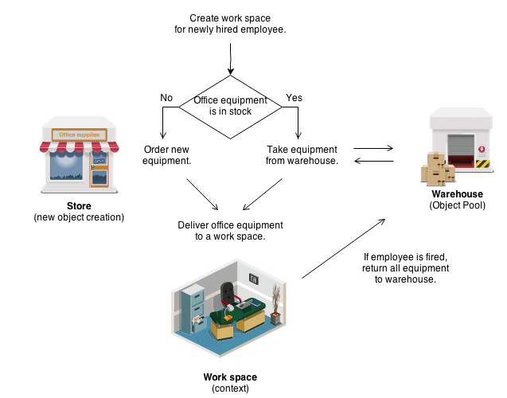
Object pool
Concept
owner hires an employee, takes the appropriate equipment from the warehouse
equipment gives to the employee
when the employee is released, the equipment is returned to the warehouse

Slide 6
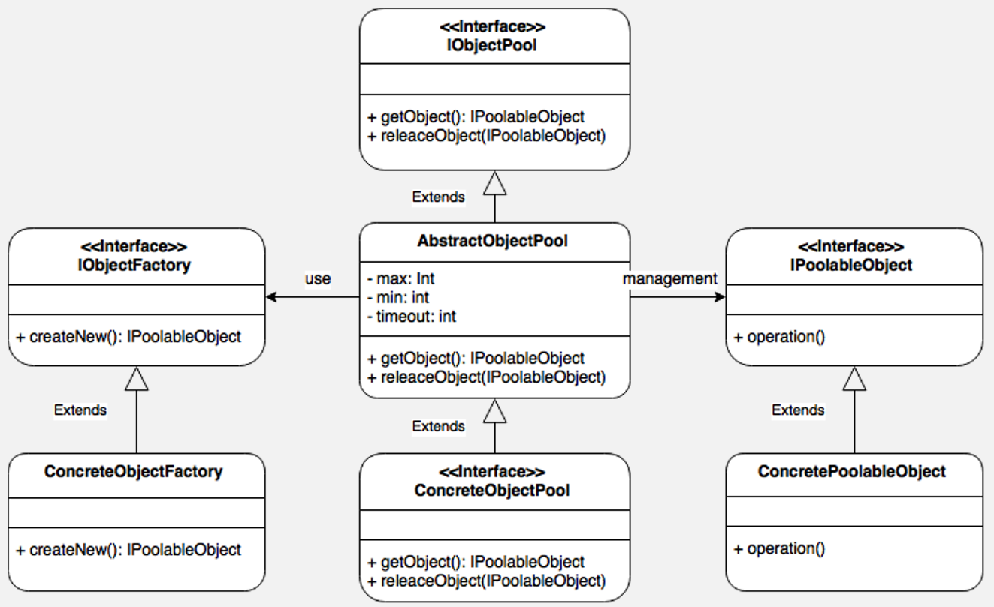
Participants
Class diagram
IObjectPool - interface which defines the basic structure of an Object Pool
AbstractObjectPool - abstract class which defines the default behavior of an Object Pool.
ConcreteObjectPool - implementation of an Object Pool.
IPoolableObject - interface which should implement all the objects we want to manage through ObjectPool.
ConcretePoolableObject - the real objects to be managed by ObjectPool.
IObjectFactory - interface which will define the structure of the ConcretePoolableObject factory.
ConcreteObjectFactory - concrete factory for the creation of a ConcretePoolableObject.
Notes:
IObjectPool - interface which defines the basic structure of an Object Pool, it has the get and release methods which will be used for getting and releasing objects, respectively.
AbstractObjectPool: Abstract class which defines the default behavior of an Object Pool, this class can be used as a basis for creating a ConcreteObjectPool more quickly.
ConcreteObjectPool: It is the complete, and ready-to-be-used, implementation of an Object Pool.
IPoolableObject: Interface which should implement all the objects we want to manage through ObjectPool. With this interface we can define the basic structure all objects should have.
ConcretePoolableObject: These are the real objects to be managed by ObjectPool, they should inherit from IPoolableObject.
IObjectFactory: Interface which will define the structure of the ConcretePoolableObject factory.
ConcreteObjectFactory: Concrete factory which implements IObjectFactory for the creation of a ConcretePoolableObject.

Slide 7
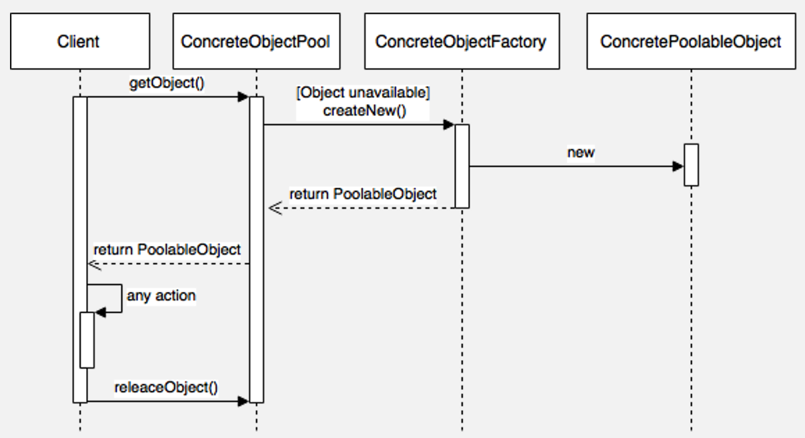
Sequence diagram
The client sends a request for an object to ConcreteObjectPool
ConcreteObjectPool checks if the required object is available, otherwise it will send the request for the creation of a new object to ConcreteObjectFactory.
ConcreteObjectFactory creates a new object whose type is ConcretePoolableObject.
ConcreteObjectPool returns the object to the client.
The client uses the object.
The client returns the object to ConcreteObjectPool.

Slide 8
Object pool strategies without spared objects in pool
fail to provide an object (and return an error to the client).
allocate a new object, thus increasing the size of the pool. Pools that do this usually allow you to set the high water mark (the maximum number of objects ever used).
in a multithreaded environment, a pool may block the client until another thread returns an object to the pool.

Slide 9
Object pool Demo

Slide 10
Object pool
Benefits
offer a significant performance boost in situations where the cost of initializing a class instance is high and the rate of instantiation and destruction of a class is high.
the pooled object is obtained in predictable time when creation of the new objects (especially over network) may take variable time.
it manages the connections and provides a way to reuse and share them.
it can provide the limit for the maximum number of objects that can be created.

Slide 11
Object pool
Pitfalls
we have to be careful to make sure the state of the objects returned to the pool is reset back to a sensible state for the next use of the object.
inadequate resetting of objects may also cause an information leak.
if the pool is used by multiple threads, it may need the means to prevent parallel threads from grabbing and trying to reuse the same object in parallel.
Notes:
When writing an object pool, the programmer has to be careful to make sure the state of the objects returned to the pool is reset back to a sensible state for the next use of the object. If this is not observed, the object will often be in some state that was unexpected by the client program and may cause the client program to fail. The pool is responsible for resetting the objects, not the clients.
inadequate resetting of objects may also cause an information leak. If an object contains confidential data (e.g. a user's credit card numbers) that isn't cleared before the object is passed to a new client,
If the pool is used by multiple threads, it may need the means to prevent parallel threads from grabbing and trying to reuse the same object in parallel. This is not necessary if the pooled objects are immutable or otherwise thread-safe.

Slide 12
Object pool
Relation with other patterns
Object pools are usually singletons
While the Prototype pattern helps in improving performance by cloning the objects, the Object pool pattern offer a mechanism to reuse objects that are expensive to create
Flyweight resources are immutable and the Object pool are mutable.
In the Object pool, at any given moment the object can be accessed only for one client, in Flyweight many clients can simultaneously use the same object.

Slide 13
Object pool
References
https://reactiveprogramming.io/books/design-patterns/en/catalog/object-pool
https://sourcemaking.com/design_patterns/object_pool
https://en.wikipedia.org/wiki/Object_pool_pattern

Slide 14
Object pool
Questions and discussion

